Slide 1
Artificial Intelligence
Reasoning Systems

Slide 2
Reasoning System Symbolic , Statistical
What is Reasoning ?
Reasoning is the act of deriving a conclusion from certain premises using a given methodology.
Reasoning is a process of thinking;
Reasoning is logically arguing نقاش;
Reasoning is drawing inference استدلال.
· It must figure out what it needs to know from what it already knows.

Slide 3
■ Example :
If we know :
Robins are birds, and
All birds have wings
Then if we ask:
Do robins have wings?
To answer this question - some reasoning must go.

Slide 4
■ Human reasoning capabilities are divided into three areas:
‡ Mathematical Reasoning – axioms, definitions, theorems, proofs
‡ Logical Reasoning – deductive, inductive, abductive
‡ Non-Logical Reasoning – linguistic , language
These three areas of reasoning, are in every human being, but the ability level depends on education, environment and genetics.
The IQ (Intelligence quotient) is the summation of mathematical
reasoning skill and the logical reasoning.
The EQ (Emotional Quotient) depends mostly on non-logical reasoning
capabilities.
Note : The Logical Reasoning is of our concern in AI

Slide 5
Uncertainty in Reasoning
■ The world is an uncertain place; often the Knowledge is imperfect (Incomplete, Inconsistent, Changing) which causes uncertainty.
Therefore reasoning must be able to operate under uncertainty.
■ AI systems must have ability to reason under conditions of uncertainty.
Uncertainties Desired action
‡ Incompleteness Knowledge Compensate for lack of knowledge
‡ Inconsistencies Knowledge Resolve ambiguities and contradictions
‡ Changing Knowledge Update the knowledge base over time

Slide 6
Sources of Uncertainty in Reasoning
In many problem domains it is not possible to create complete, consistent models of the world.
Therefore agents (and people) must act in uncertain worlds.
We want an agent to make rational decisions even when there is no enough information to prove that an action will work.
■ Uncertainty is present because of
‡ Incompleteness
‡ Incorrectness
■ Uncertainty in Data or Expert Knowledge
‡ Data derived from defaults/assumptions
‡ Inconsistency between knowledge from different experts.
‡ “Best Guesses”

Slide 7
■ Uncertainty in Knowledge Representation
‡ Restricted model of the real system.
‡ Limited expressiveness of the representation mechanism.
■ Uncertainty in Rules or Inference Process
‡ Incomplete because too many conditions to be explicitly enumerated
‡ Incomplete because some conditions are unknown
‡ Conflict Resolution

Slide 8
Monotonic Logic رتيب
a logic is monotonic if the truth of a proposition does not change when new information (axioms) are added.
Formal logic is a set of rules for making deductions that seem self evident.
The traditional logic is monotonic.
The human reasoning is non-monotonic in nature.
This means, we reach to conclusions from certain premises that we would not reach if certain other sentences are included in our premises.

Slide 9
Non-Monotonic Logic
A logic is non-monotonic if the truth of a proposition may change when new information (axioms) are added.
The non-monotonic human reasoning is caused by the fact that our knowledge about the world is always incomplete .
Therefore we often revise our conclusions, when new information becomes available.
Example :
Birds typically fly.
Tweety is a bird.
--------------------------
Tweety (presumably محتمل) flies.

Slide 10
Different Methods of Reasoning
Mostly Four kinds of logical reasoning:
Deduction الاستنتاج
Induction الاستقراء
Abduction التخمين
Analogy التماثل

Slide 11
Deduction Reasoning
Deduction :
Reason from facts and general principles to other facts.
Guarantees that the conclusion is true.
Example:
"When it rains, the grass gets wet. It rains. Thus, the grass is wet."
This means that; it is using rule and its precondition to make a conclusion.
Applying a general principle to a special case.
Using theory to make predictions
Usage: Inference engines, Theorem provers, Planning.

Slide 12
■ Modus Ponens :
Latin for "the way of affirming"
It is a valid form of argument affirming the antecedent (premises)
Example:
◊ If it is rainy, John carries an umbrella
It is rainy
----------------- (doted line read as "therefore")
John carries an umbrella.
◊ If p then q , p or as (( P → Q) ∧ P) → Q
----
Q

Slide 13
Explanation of (( P → Q) ∧ P) → Q
The argument form has two premises.
The first premise is the "if–then" or conditional claim, namely that P implies Q.
The second premise is that P, the antecedent of the conditional claim, is true.
From these two premises it can be logically concluded that Q, the consequent of the conditional claim, must be true as well.
In AI modus ponens is often called Forward Chaining
example :
If today is Tuesday, then John will go to work.
Today is Tuesday. Therefore, John will go to work.

Slide 14
‡ Modus Tollens : a valid form of argument denying انكار the consequent.
◊ If it is rainy, John carries an umbrella
John does not carry an umbrella
-------------------------------------(doted line read as "because")
It is not rainy
◊ If p then q
not q
-------
not p

Slide 15
Induction Reasoning
Reasoning from many instances to all instances.
Deriving a general principle from special cases
From observations to generalizations to knowledge
Example: "The grass has been wet every time it has rained. Thus, when it rains, the grass gets wet.“
This means; it is learning the rule after numerous examples of conclusion following the precondition.
Usage: Neural nets, Bayesian nets, Pattern recognition
Advantage : Inductive inference may be useful even if not correct.
It generates a proposition which may be validated deductively.

Slide 16
■ Induction Examples
‡ Good Movie
Fact You have liked all movies starring Mery.
Inference You will like her next movie.
‡ Birds
Facts: Woodpeckers, swifts, eagles, finches have four toes on each foot.
Inductive All birds have 4 toes on each foot.
Inference
(Note: partridges have only 3).

Slide 17
‡ Objects
Facts : Cars, bottles, blocks fall if not held up.
Inductive Inference : If not supported, an object will fall.
(Note: an unsupported helium balloon will rise.)
‡ Medicine
Noted : People who had cowpox جدري البقر did not get smallpox الجدري.
Induction: Cowpox prevents smallpox.
Problem : Sometime inference is correct, sometimes not correct.

Slide 18
Abduction Reasoning
Guessing that some general principle can relate a given pattern of cases
Extract hypotheses to form a tentative مؤقت theory
In Abductive reasoning you make an assumption which, if true, together with your general knowledge, will explain the facts.
Usage: Knowledge discovery, Statistical methods, Data mining.
Problem: Not always correct; many explanations possible.
Advantage : Understandable conclusions.

Slide 19
■ Abduction Examples
Rain Example: "When it rains, the grass gets wet. The grass is wet, it must have rained."
Means that; it is using the conclusion and the rule to support that the precondition could explain the conclusion.
Dating example:
Fact: Mary asks John to a party.
Abductive Inferences : Mary likes John.
John is Mary's last choice.
Mary wants to make someone else jealous غيور.

Slide 20
Smoking house example:
Fact: A large amount of black smoke is coming from a home.
Abduction 1: the house is on fire.
Abduction 2: bad cook.
Diagnosis
Facts: A thirteen year-old boy has a sharp pain in his right side, a fever, and a high white blood count.
Abductive inference: Appendicitis التهاب الزائدة.

Slide 21
Analogy Reasoning
Means analogous; it is illustration of an idea by means of a more familiar idea that is similar to it in some significant features. and thus said to be analogous to it.
Finding a common pattern in different cases
Usage: Matching labels, Matching sub-graphs, Matching transformations.
‡ Example: "An atom, with its nucleus and electrons, is like the solar system, with its sun and planets."
Problems : Few analogical inferences are correct
Advantage : Suggests novel possibilities. Helps to organize information.

Slide 22
■ Analogy Examples
Analogical Reasoning yields possibilities.
If A is like B in some ways, then infer A is like B in other ways.
‡ Atom and Solar System
Statements: An atom, with its nucleus and electrons, is like the solar system, with its sun and planets.
Inferences: Electrons travel around the nucleus.
Orbits are circular.
? Orbits are all in one plane.
? Electrons have little people living on them.
Idea: Transfer information from known (source)
to unknown (target).

Slide 23
‡ Sun and Girl
Statement: She is like the sun to me.
Inferences: She lights up my life.
She gives me warmth.
? She is gaseous.
? She is spherical.
‡ Sale man Logic
Statement: John has a fancy car and a pretty girlfriend.
Inferences: If Peter buys a fancy car, Then Peter will have a pretty girlfriend.
Note: Deductive reasoning and Inductive reasoning are the two most commonly used explicit methods of reasoning to reach a conclusion.

Slide 24
Approaches to Reasoning
There are three different approaches to reasoning under uncertainties.
‡ Symbolic reasoning
‡ Statistical reasoning
‡ Fuzzy logic reasoning
The first two approaches are presented in the subsequent slides.

Slide 25
1. Symbolic Reasoning
The basis for intelligent mathematical software is the integration of the "power of symbolic mathematical tools" with the suitable "proof technology".
Monotonic Reasoning
If a conclusion follows from given premises A, B, C, … then it also follows from any larger set of premises, as long as the original premises A, B, C, … are included.
Human reasoning is not monotonic.
Non-Monotonic Reasoning
conclusions are only tentative مؤقتاً, based on partial or incomplete information, reserve the right to retract يتراجع those conclusions while they learn new facts.

Slide 26
Non-Monotonic Reasoning
Non-monotonic reasoning attempts to formalize reasoning with incomplete information by classical logic systems.
The Non-Monotonic reasoning are of the type
■ Default reasoning
■ Circumscription محيط
■ Truth Maintenance Systems

Slide 27
Default Reasoning
The conclusions are drawn based on what is most likely to be true.
There are two approaches, both are logic type, to Default reasoning :
Predicate logic
Default logic.

Slide 28
Predicate Logic
Predicate logic with one extension called modal operator M which means “consistent with everything we know”.
The purpose of M is to allow consistency.
A way to define consistency with PROLOG notation is :
To show that fact P is true, we attempt to prove ¬P.
If we fail we may say that P is consistent since ¬P is false.
Example :
∀x : plays_instrument(x) ∧ M manage(x) → jazz_musician(x)
States that for all x, the x plays an instrument and if the fact that x can manage is consistent with all other knowledge then we can conclude that x is a jazz musician.

Slide 29
Default Logic
Default logic initiates a new inference rule: A:B / C
Where:
A is known as the prerequisite,
B as the justification تبرير, and
C as the consequent.
‡ Read the above inference rule as:
" if A, and if it is consistent with the rest of what is known to assume that B, then conclude that C ".
OR
‡ The rule says that given the prerequisite, the consequent can be inferred, provided it is consistent with the rest of the data.

Slide 30
Example : Rule that "birds typically fly" would be represented as
bird(x) : flies(x)
flies (x)
which says " If x is a bird and the claim that x flies is consistent with what we know, then infer that x flies".
Note : Since, all we know about Tweety is that :
Tweety is a bird, we therefore inferred that Tweety flies.
‡ The idea behind non-monotonic reasoning is to reason with first order logic, and if an inference can not be obtained then use the set of default rules available within the first order formulation.

Slide 31
Circumscription محيط
Circumscription is a non-monotonic logic to formalize the common sense assumption.
Circumscription involves formulating rules of thumb with "abnormality“ predicates and then restricting the extension of these predicates, so that they apply to only those things to which they are currently known.
■ Example :
Take the case of Bird Tweety
The rule of thumb is that "birds typically fly" is conditional.
The predicate "Abnormal” signifies abnormality with respect to flying ability
Observe that the rule
∀x(Bird(x) & ¬ Abnormal(x) → Flies))
Does not allow us to infer that "Tweety flies",

Slide 32
2. Statistical Reasoning :
In the logic-based approaches described, we have assumed that everything is either believed false or believed true.
However, it is often useful to represent the fact that we believe such that something is probably true, or true with probability (say) 0.65.
This is useful for dealing with problems where there is randomness and unpredictability (such as in games of chance).
To do all this in a principled way requires techniques for probabilistic reasoning.
In this section, the Bayesian Probability Theory is first described and then discussed how uncertainties are treated.

Slide 33
Recall glossary of terms
■ Probabilities :
Usually, are descriptions of the likelihood of some event occurring (ranging from 0 to 1).
■ Event :
One or more outcomes of a probability experiment .
■ Probability Experiment :
Process which leads to well-defined results call outcomes.
■ Sample Space :
Set of all possible outcomes of a probability experiment.
■ Independent Events :
Two events, E1 and E2, are independent if the fact that E1 occurs does not affect the probability of E2 occurring.
■ Mutually Exclusive Events :
Events E1, E2, ..., En are said to be mutually exclusive if the occurrence of any one of them automatically implies the non-occurrence of the remaining n − 1 events.
■ Disjoint Events :
Another name for mutually exclusive events.

Slide 34
■ Classical Probability :
Also called a priori theory of probability.
The probability of event A = no of possible outcomes f divided by the total no of possible outcomes n ;
ie., P(A) = f / n
Assumption: All possible outcomes are equal likely.
■ Empirical Probability :
Determined analytically, using knowledge about the nature of the experiment rather than through actual experimentation.
■ Conditional Probability :
The probability of some event A, given the occurrence of some other event B. Conditional probability is written P(A|B), and read as "the probability of A, given B ".
■ Joint probability :
The probability of two events in conjunction. It is the probability of both events together. The joint probability of A and B is written P(A ∩ B) ; also written as P(A, B).

Slide 35
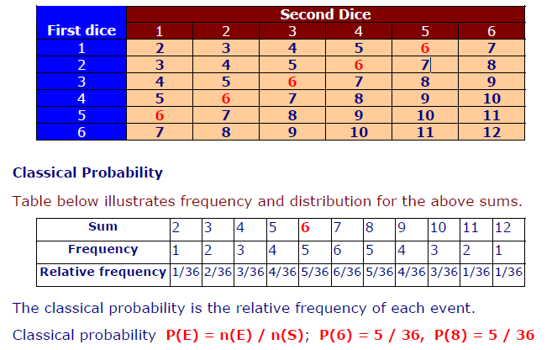
■ Example 1
Sample Space - Rolling two dice
The sums can be { 2, 3, 4, 5, 6, 7, 8, 9, 10, 11, 12 }.
Note that each of these are not equally likely.
The only way to get a sum 2 is to roll a 1 on both dice, but can get a sum 4 by rolling out comes as (1,3), (2,2), or (3,1).
Table below illustrates a sample space for the sum obtain.

Slide 36
■ Example 2
Mutually Exclusive Events (disjoint) :
means nothing in common.
Two events are mutually exclusive if they cannot occur at the same time.
If two events are mutually exclusive,
then probability of both occurring at same time is P(A and B) = 0
(b) If two events are mutually exclusive ,
then the probability of either occurring is P(A or B) = P(A) + P(B)
Given P(A)= 0.20, P(B)= 0.70, where A and B are disjoint
then P(A and B) = 0
and P(A or B) = 0.90

Slide 37
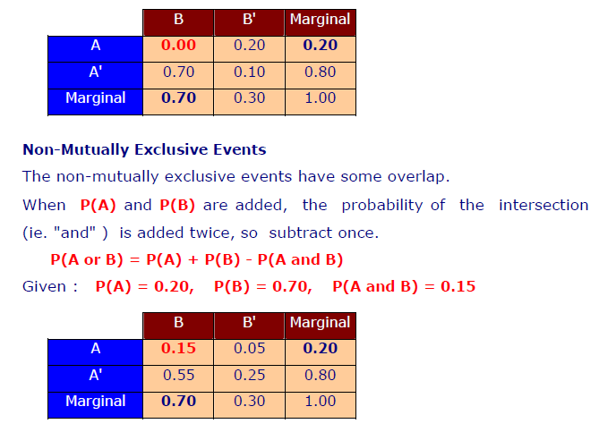
The table below indicates intersections ie. "and“ of each pair of events.
"Marginal" means total; the values in bold means given; the rest of the values are obtained by addition and subtraction.

Slide 38
Permutation
The permutation is arranging elements (objects or symbols) into
distinguishable sequences. The ordering of the elements is important.
Each unique ordering is a permutation.
Number of permutations of ‘ n ’ different things taken ‘ r ’ at a time is given by:
Example 4
Consider a total of 10 elements, say integers {1, 2, ..., 10}.
A permutation of 3 elements from this set is (5, 3, 4).
Here n = 10 and r = 3.
The number of such unique sequences are calculated as P(10,3) = 720.

Slide 39
Example 5
Find the number of ways to arrange the three letters in the word CAT in to two-letter groups like CA or AC and no repeated letters.
This means size n = 3.
permutations are of size r = 2 taken from a set of
so P(n, r) = P(3,2) = 6.
The ways are listed as CA CT AC AT TC TA.
Similarly, permutations of size r = 4, taken from a set of size n = 10,

Slide 40
Combinations
Combination means selection of elements (objects or symbols).
The ordering of the elements has no importance.
Number of Combination of ‘ n ’ different things, taken ‘ r ’ at a time is

Slide 41
Example 6
Find the number of combinations of size 2 without repeated letters that can be made from the three letters in the word CAT, order doesn't matter; AT is the same as TA.
This means combinations of size r =2 taken from a set of size n = 3,
so C(n , r) = C(3 , 2) = 3 .
The ways are listed as CA CT CA .
Using the formula for finding the number of combinations of r objects from a set of n objects is:

Slide 42
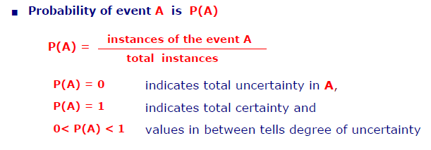
3.1 Probability and Bayes’ Theorem
In probability theory, Bayes' theorem relates the conditional and marginal probabilities of two random events.
Probability :
The Probabilities are numeric values between 0 and 1 (both inclusive) that represent ideal uncertainties.

Slide 43
Probability Rules :
‡ All probabilities are between 0 and 1 inclusive 0 <= P(E) <= 1.
‡ The sum of all the probabilities in the sample space is 1.
‡ The probability of an event which must occur is 1.
‡ The probability of any event which is not in the sample space is zero.
‡ The probability of an event not occurring is P(E') = 1 - P(E)

Slide 46
■ Conditional probability P(A|B)
A conditional probability is the probability of an event given that another event has occurred.
Example : Roll two dices.
What is the probability that the total of two dice will be greater than 8 given that the first die is a 6 ?

Slide 47
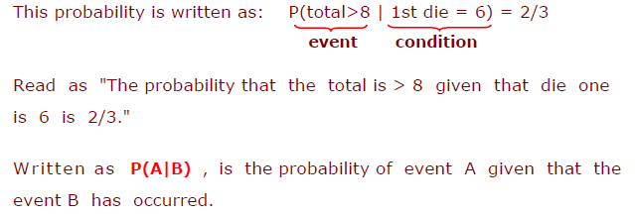
There are 6 outcomes for which the first die is a 6, and of these, there are 4 outcomes that total more than 8 are (6,3; 6,4; 6,5; 6,6).
The probability of a total > 8 given that first die is 6 is
therefore 4/6 = 2/3 .

Slide 48
■ Probability of A and B is P(A and B)
The probability that events A and B both occur.
Note : Two events are independent if the occurrence of one is unrelated to the probability of the occurrence of the other.
‡ If A and B are independent
then probability that events A and B both occur is:
P(A and B) = P(A) x P(B)
ie product of probability of A and probability of B.
‡ If A and B are not independent
then probability that events A and B both occur is:
P(A and B) = P(A) x P(B|A)
where
P(B|A) is conditional probability of B given A

Slide 49
Example 1: P(A and B) if events A and B are independent
Draw a card from a deck , then replace it, draw another card.
Find probability that 1st card is Ace of clubs (event A) and 2nd
card is any Club (event B).
Since there is only one Ace of Clubs, therefore probability
P(A) = 1/52.
Since there are 13 Clubs, the probability
P(B) = 13/52 = 1/4.
Therefore, P(A and B) = p(A) x p(B)
= 1/52 x 1/4 = 1/208.

Slide 50
Example 2: P(A and B) if events A and B are not independent
Draw a card from a deck, not replacing it, draw another card. Find probability that both cards are Aces ie the 1st card is Ace (event A) and the 2nd card is also Ace (event B).
Since 4 of 52 cards are Aces, therefore probability
P(A) = 4/52
= 1/13.
Of the 51 remaining cards, 3 are aces. so, probability of 2nd
card is also Ace (event B) is P(B|A) = 3/51 = 1/17.
Therefore, P(A and B) = p(A) x p(B|A)
= 1/13 x 1/17 = 1/221

Slide 51
■ Probability of A or B is P(A or B)
The probability of either event A or event B occur.
Two events are mutually exclusive if they cannot occur at same time.
‡ If A and B are mutually exclusive
then probability that events A or B occur is:
P(A or B) = p(A) + p(B)
i.e. sum of probability of A and probability of B
‡ If A and B are not mutually exclusive
then probability that events A and B both occur is:
P(A or B) = p(A) + p(B) – P(A and B) where
P(A and B) is probability that events A and B both occur while events A and B are independent.

Slide 52
Example 1: P(A or B) if events A or B are mutually exclusive
Rolling a die.
Find probability of getting either, event A as 1 or event B as 6?
Since it is impossible to get both, the event A as 1 and event B as 6 in same roll, these two events are mutually exclusive.
The probability P(A) = P(1) = 1/6 and P(B) = P(6) = 1/6
Hence probability of either event A or event B is :
P(A or B) = p(A) + p(B) = 1/6 + 1/6 = 1/3

Slide 53
Example 2: P(A or B) if events A or B are not mutually exclusive
Find probability that a card from a deck will be either an
Ace or a Spade?
probability P(A) is P(Ace) = 4/52 and
P(B) is P(spade) = 13/52.
Only way in a single draw to be Ace and Spade is Ace of Spade; which is only one,
so probability P(A and B) is P(Ace and Spade) = 1/52.
Therefore, the probability of event A or B is :
P(A or B) = P(A) + P(B) – P(A and B)
= P(ace) + P(spade) - P(Ace and Spade)
= 4/52 + 13/52 - 1/52 = 16/52 = 4/13

Slide 55
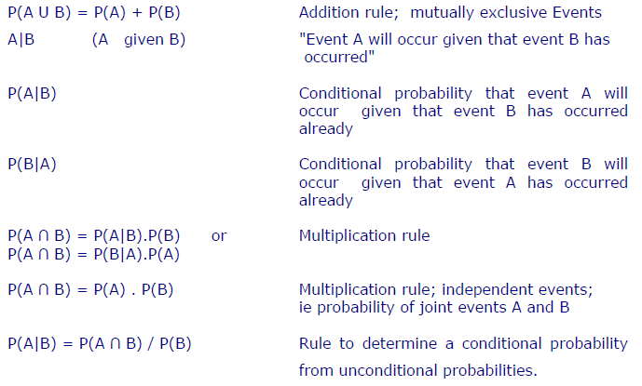

Slide 56
Bayesian reasoning
Bayesian view of probability is related to degree of belief.
It is a measure of the plausibility تصديق of an event given incomplete knowledge.
The probability of an event A conditional on another event B ie P(A|B) is generally different from probability of B conditional on A ie P(B|A).
There is a definite relationship between the two, P(A|B) and P(B|A), and Bayes' theorem is the statement of that relationship.
Bayes theorem is a way to calculate P(A|B) from a knowledge of P(B|A).

Slide 58
Applying Bayes' Theorem :
Bayes' theorem is applied while following conditions exist.
‡ the sample space S is partitioned into a set of mutually exclusive events {A1, A2, . . . . . , An }.
‡ within S, there exists an event B, for which P(B) > 0.
‡ the goal is to compute a conditional probability of the form :
P(Ak|B)
‡ you know at least one of the two sets of probabilities described below
◊ P(Ak ∩ B) for each Ak
◊ P(Ak) and P(B|Ak) for each Ak

Slide 59
Example 1: Applying Bayes' Theorem
Problem : Marie's marriage is tomorrow.
in recent years, each year it has rained only 5 days.
the weatherman has predicted rain for tomorrow.
when it actually rains, the weatherman correctly forecasts rain 90% of the time.
when it doesn't rain, the weatherman incorrectly forecasts rain 10% of the time.
The question : What is the probability that it will rain on the day of Marie's wedding?

Slide 60
Solution : The sample space is defined by two mutually exclusive events
– "it rains" or "it does not rain". Additionally, a third event occurs when the "weatherman predicts rain".
The events and probabilities are stated below.
◊ Event A1 : rains on Marie's wedding
◊ Event A2 : does not rain on Marie's wedding
◊ Event B : weatherman predicts rain.
◊ P(A1) = 5/365 =0.0136985 [Rains 5 days in a year.]
◊ P(A2) = 360/365 = 0.9863014 [Does not rain 360 days in a year.]
◊ P(B|A1) = 0.9 [When it rains, the weatherman predicts rain 90% time.]
◊ P(B|A2) = 0.1 [When it does not rain, weatherman predicts rain 10% time.]

